Slide 1
CEGE0096: Geospatial Programming
Lecture 9: Algorithms
Dr. Aldo Lipani

Slide 2
Outline
Complexity analysis
Algorithm Classification
How to derive the complexity for a given algorithm
Searching
Linear Search
Binary Search
Sorting
Bubble Sort
Binary Tree
Tree Navigation

Slide 3
Algorithms and complexity Analysis

Slide 4
Algorithm (Recap)
Finite sequence of instructions which:
Solve a problem;
Satisfy the following criteria:
Receive input values;
Produce output values;
Are unambiguous and executable;
Terminates.
Operate on data structures.
However, a given problem can have many different solutions, i.e. it can be implemented in many ways:
How to choose the most efficient solution?

Slide 5
Timing a program
One approach is to measure the execution time:
We can implement the solution by writing a computer program,
Execute the program;
Time it.
Notes:
4

Slide 6
Timing a program
Measuring the execution time of an algorithm
def my_sum(numbers): res = 0 for number in numbers: res = res + number return res numbers = [1, 10, 20, 30, 40, 50] start = time.time() my_sum(numbers) end = time.time() print(end - start)
Notes:
5

Slide 7
Timing a program
Timing a program is inconsistent:
the amount of data that must be processed directly affects the execution time;
the execution time vary depending on the type of hardware used:
it varies between computers,
it varies between implementations;
the programming language and the compiler used influence the execution time.
We need a robust method to analyze an algorithm’s efficiency independent of the implementation details.
Notes:
6

Slide 8
Complexity Analysis
The most valuable option is to perform a complexity analysis, which is an estimate of the resources required by the algorithm for its execution:
Independently from the hardware;
Dependent only on the size of input n.
Output: execution time T(n)
We rely on the Big-O notation which describes how quickly runtime will grow relative to the input, as the input get arbitrarily large.
Big-O notation measures an upper bound on the asymptotic growth;
Describes the worst case;
Excludes coefficients and lower order terms.
Notes:
7

Slide 9
Asymptotic analysis of worst case
Objective:
Estimate of an upper limit of T(n), which represents the approximate number of steps required by an algorithm for an input of size n.
Asymptotic, n → ∞ :
For n small, the complexity is irrelevant.
Worst case:
The worst case occurs often;
It is the bottleneck when a program runs.

Slide 10
Algorithms CLASSIFICATION

Slide 11

Algorithms Classification
$1$: constant
$log⁡(n)$: logarithmic
$n$: linear
$n log⁡(n)$: linearithmic
$n2$: quadratic
$n3$: cubic
$2n$: exponential
Time
Input Size
Notes:
10

Slide 12
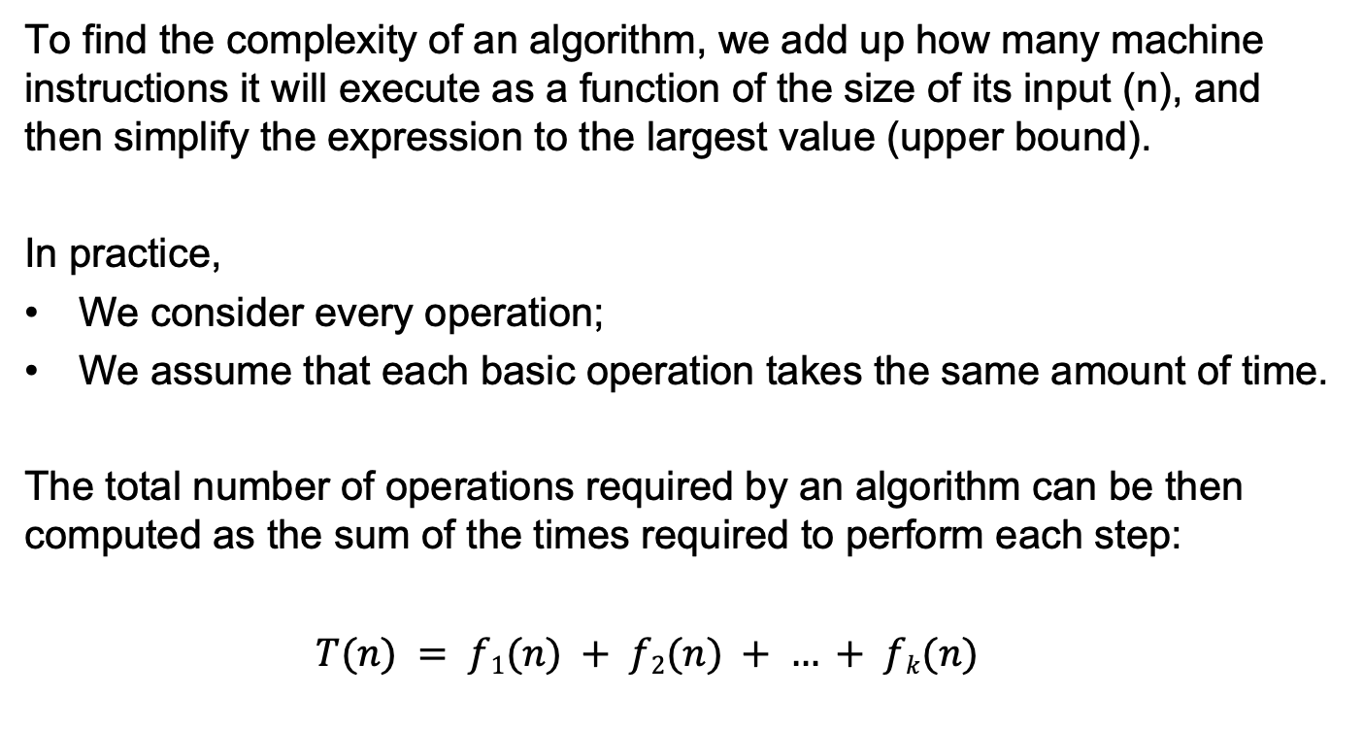
Constructing T(n)
To find the complexity of an algorithm, we add up how many machine instructions it will execute as a function of the size of its input (n), and then simplify the expression to the largest value (upper bound).
In practice,
We consider every operation;
We assume that each basic operation takes the same amount of time.
The total number of operations required by an algorithm can be then computed as the sum of the times required to perform each step:
$T(n) = f1(n) + f2(n) + … + fk(n)$

Slide 13

Constructing T(n)
Constant time example
Not dependent on the size of input data (n)
$$T(n) = 1 ⇒ O(1)$$
def is_greater(a, b): if a > b: return True else: return False
1

Slide 14
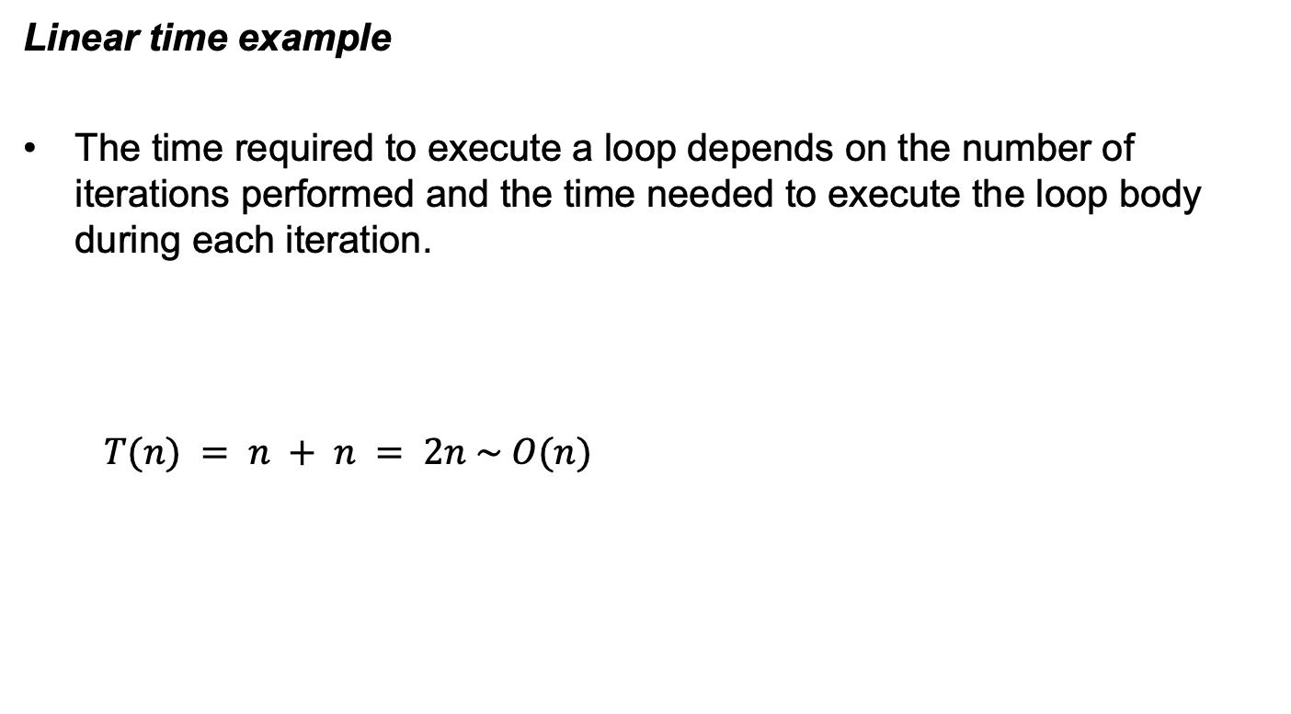
Constructing T(n)
Linear time example
The time required to execute a loop depends on the number of iterations performed and the time needed to execute the loop body during each iteration.
$$T(n) = n + n = 2n \sim O(n)$$
def linear_example(n): res = 0 for _ in range(n): res = res + 1 for _ in range(n): res = res + 1 return res
n
n

Slide 15
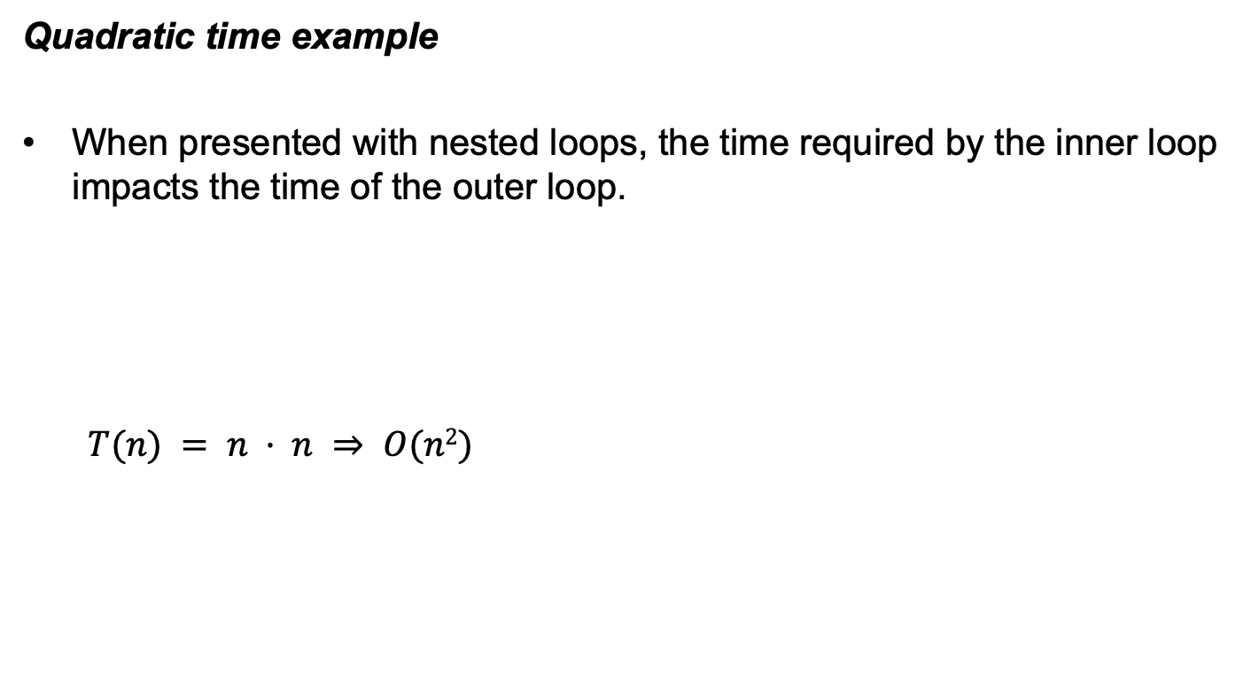
Constructing T(n)
Quadratic time example
When presented with nested loops, the time required by the inner loop impacts the time of the outer loop.
$$T(n) = n · n ⇒ O(n2)$$
def squared_matrix_sum(matrix, n): res = 0 for i in range(n): for j in range(n): res = res + matrix[i, j] return res
n
n

Slide 16
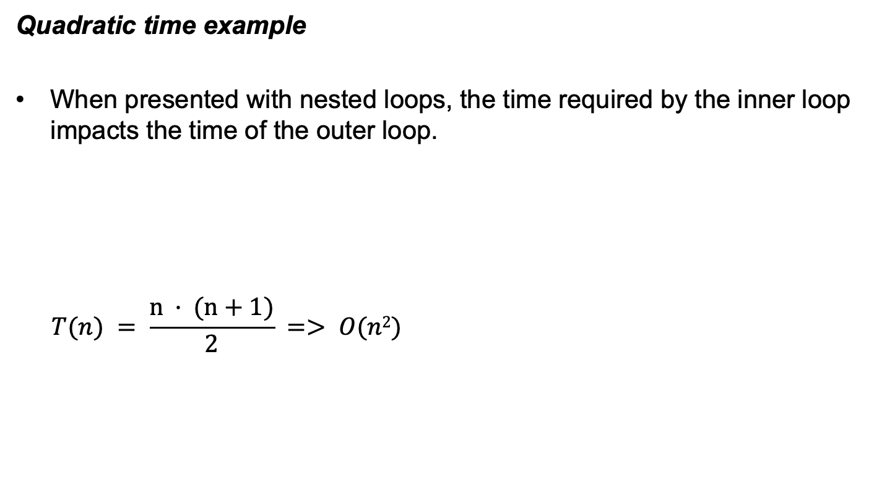
Constructing T(n)
Quadratic time example
When presented with nested loops, the time required by the inner loop impacts the time of the outer loop.
$$T(n) = \frac{n · (n+1)}{2} => O(n2)$$
def nested_loop(n): count = 0 for i in range(n): for j in range(i + 1): count += 1 return count
n
i +1

Slide 17
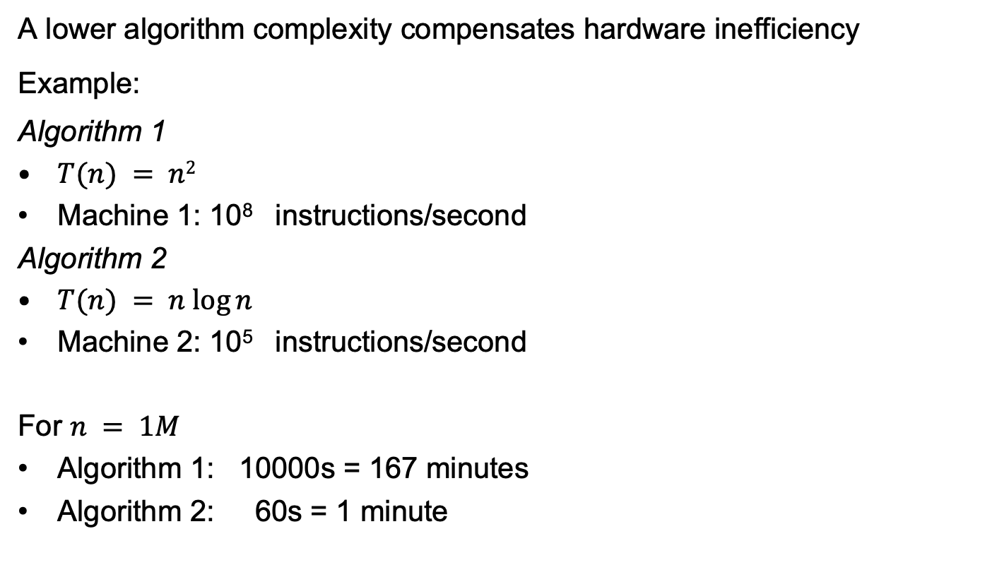
Importance of the complexity analysis
A lower algorithm complexity compensates hardware inefficiency
Example:
Algorithm 1
$T(n) = n2$
Machine 1: 10⁸ instructions/second
Algorithm 2
$T(n) = n log⁡n$
Machine 2: 10⁵ instructions/second
For $n = 1M$
Algorithm 1: 10000s = 167 minutes
Algorithm 2: 60s = 1 minute

Slide 18
SEARCHING ALGORITHMS

Slide 19
Searching
Searching is the process of selecting information from a collection of data based on a given criteria.
The sequence search involves finding an item within a sequence using a search key to identify the specific item.
A search key is a unique value used to identify the data elements of a collection.

Slide 20
The Linear Search (Sequential Search)
The Linear Search (or Sequential Search) is the simplest solution to the sequence search problem.
This technique iterates over the sequence, one item at a time, until the specific item is found, or all the items have been examined.
Worst case: need to iterate over all the n elements of the sequence => O(n)
def linear_search(xs, key): for x in xs: if x == key: return True return False

Slide 21
The Linear Search
In Python this can be easily done through the “in” operator:
if key in xs: print('the key is in the list') else: print('the key is not in the list')

Slide 22
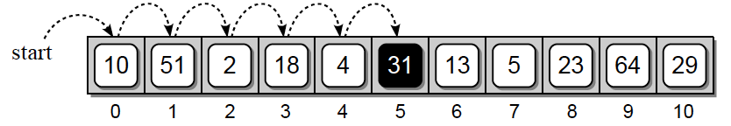
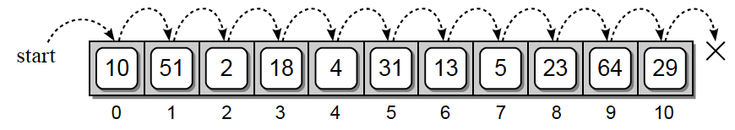
The Linear Search: unsorted sequence
Searching on an unsorted sequence
Searching for “31”: the target item is found
Searching for “8”: the item is not in the array, but all the sequence is traversed
Data Structures and Algorithms Using Python, Rance D. Necaise. John Wiley&Sons, Incorporated, 2010

Slide 23
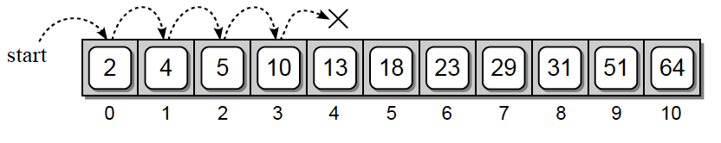
The Linear Search: sorted sequence
On a sorted sequence, the values in the array are in ascending or increasing numerical order, i.e. each value is larger than its predecessor.
It is possible to end the search earlier, when the value is not in the sequence, instead of always having to perform a complete traversal.
Searching for “8”: the item is not in the array, stop iterating
Data Structures and Algorithms Using Python, Rance D. Necaise. John Wiley&Sons, Incorporated, 2010

Slide 24
The Linear Search: sorted sequence
If a larger value is encountered, the loop terminates and False is returned.
However, the time-complexity remains the same! The worst case occurs when the value is not in the sequence and is larger than the last element ⇒ O(n)
def sorted_linear_search(xs, key): for x in xs: if x == key: return True elif x > key: return False return False

Slide 25
The Linear Search: look for the minimum
Linear search can as well be used to search for the smallest or largest value in an unsorted list
Instead of searching for a specific value in an unsorted sequence, we want to search for the smallest value
We perform a linear search as done before but now we must keep track of the smallest value found for each iteration through the loop
Equivalent to applying Python's min function to the list

Slide 26
The Linear Search: look for the minimum
Since the smallest value can occur anywhere in the sequence, we must always perform a complete traversal => O(n)
def find_minimum(xs): # Assume the first item is the smallest value. minimum = xs[0] # Determine if any other item in the sequence is smaller for x in xs[1:]: if x < minimum: minimum = x return minimum

Slide 27
The Linear Search: look for the maximum
Since the largest value can occur anywhere in the sequence, we must always perform a complete traversal => O(n)
def find_maximum(xs): # Assume the first item is the largest value. maximum = xs[0] # Determine if any other item in the sequence is greater for x in xs[1:]: if x > maximum: maximum = x return maximum

Slide 28
The Binary Search
To improve the search time for a sorted sequence, we can modify the search technique itself.
Based on the “divide and conquer” strategy: divide a larger problem into smaller parts and conquering the smaller part.
Lower number of steps!

Slide 29
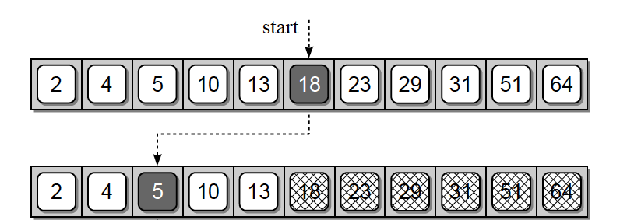
The Binary Search
Search “10” using the binary search
The middle entry contains 18, which is greater than our target of 10
we can discard the upper half of the array from consideration since 10 cannot possibly be in that part.
We repeat the process on the lower half of the array
Data Structures and Algorithms Using Python, Rance D. Necaise. John Wiley&Sons,, 2010

Slide 30
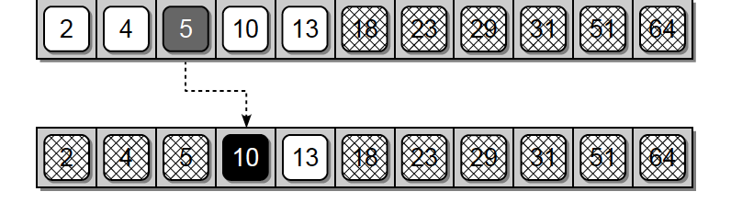
The Binary Search
Search “10” using the binary search
We then find the middle item of the lower half and compare its value to the target
Since that entry, which contains 5, is lower than the target, we can eliminate the lower fourth of the array.
The process is repeated on the remaining items.
We find the value 10 in the middle entry of the sequence under consideration => the process terminates successfully.
Data Structures and Algorithms Using Python, Rance D. Necaise. John Wiley&Sons,, 2010

Slide 31
The Binary Search
def binary_search(xs, key): low = 0 high = len(xs) - 1 # Repeatedly subdivide the sequence in half until the key is found. while low <= high: # Find the midpoint of the sequence. mid = (high + low) // 2 # Check if the midpoint coincide with the key if xs[mid] == key: return True # Or does the key precede the midpoint? elif key < xs[mid]: high = mid - 1 # Or does it follow the midpoint? else: low = mid + 1 # If the sequence cannot be subdivided further, we're done. return False
range of elements in the sequence currently under consideration

Slide 32
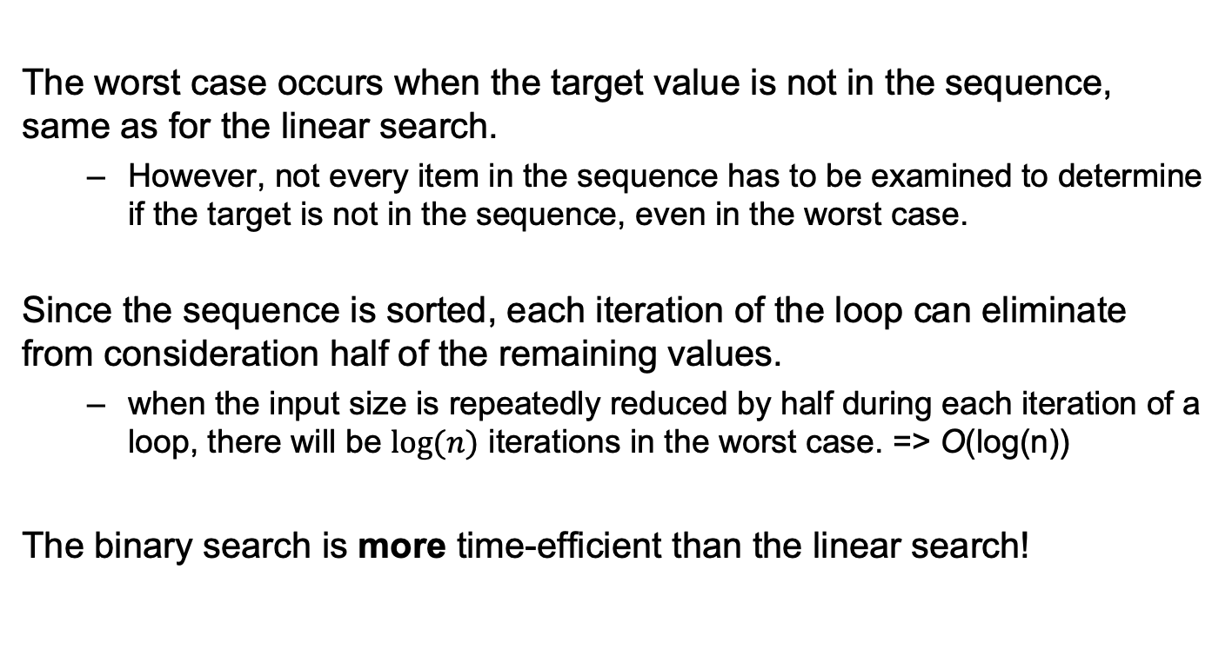
The Binary Search: complexity analysis
The worst case occurs when the target value is not in the sequence, same as for the linear search.
However, not every item in the sequence has to be examined to determine if the target is not in the sequence, even in the worst case.
Since the sequence is sorted, each iteration of the loop can eliminate from consideration half of the remaining values.
when the input size is repeatedly reduced by half during each iteration of a loop, there will be $log⁡(n)$ iterations in the worst case. => O(log(n))
The binary search is more time-efficient than the linear search!

Slide 33
SORTING Algorithms

Slide 34
Sorting
Sorting is the process of arranging or ordering a collection of items such that each item and its successor satisfy a prescribed relationship.
One of the most studied problems in computer science: a lot of solutions have been proposed to tackle it in an efficient manner
Some of them simple and intuitive (Bubble Sort)
Others more complex but more efficient (Quick Sort)
They can be divided in two classes depending on their complexity
O(n²) Bubble, Insertion, Selection and Shell Sort
O(n log(n)) Heap, Merge and Quick Sort

Slide 35
Bubble Sort
The oldest and simplest sorting algorithm
consists in rearranging the values by iterating over the list multiple times, causing larger values to bubble to the top (if descending) or end of the list (if ascending).
It repeatedly iterates through the list, comparing adjacent elements and swapping them if they are in the wrong order. The pass through the list is repeated until the list is sorted.
Example:
https://en.wikipedia.org/wiki/Bubble_sort

Slide 36
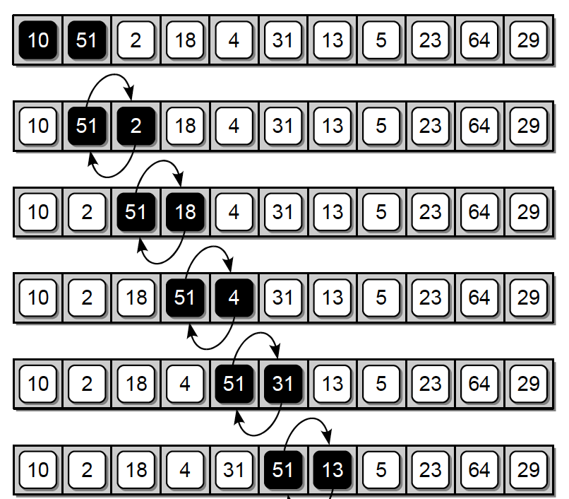
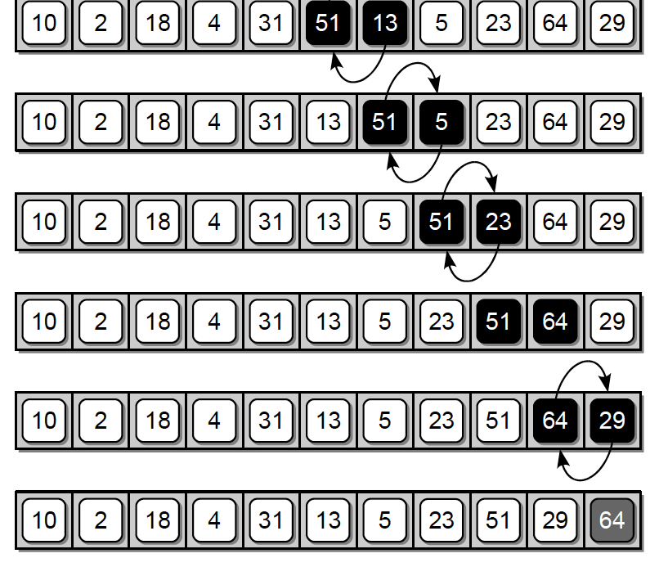
Bubble Sort
First complete pass of the Bubble sort algorithm, which places 64 in its correct position:
Data Structures and Algorithms Using Python, Rance D. Necaise. John Wiley&Sons,, 2010

Slide 37
Bubble Sort
def bubble_sort(xs): n = len(xs) # perform n-1 bubble operations on the sequence for i in range(n - 1): # bubble the largest item to the end. for j in range(0, n – i - 1): if xs[j] > xs[j + 1]: # swap the j and j+1 items. xs[j], xs[j + 1] = xs[j + 1], xs[j]

Slide 38
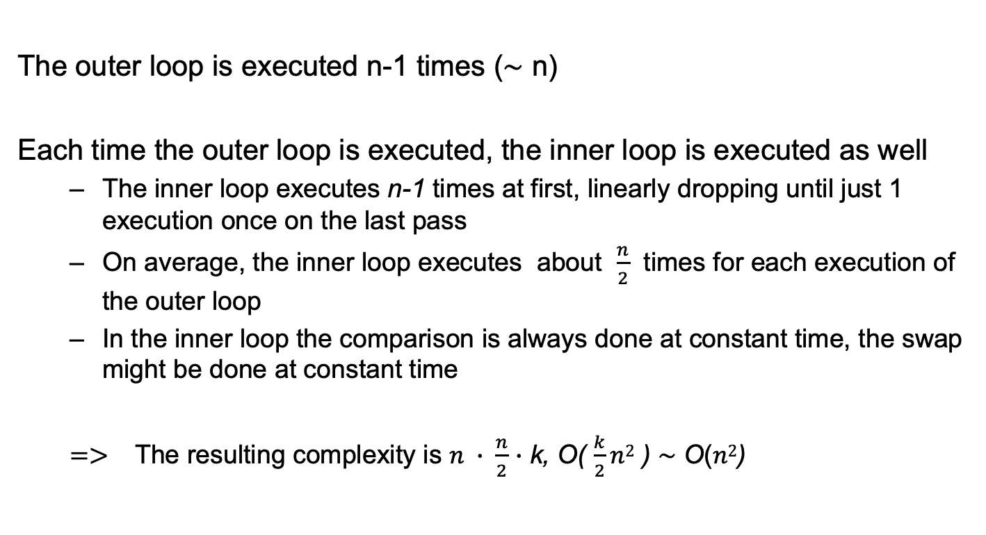
Bubble Sort: complexity analysis
The outer loop is executed n-1 times ($\sim$ n)
Each time the outer loop is executed, the inner loop is executed as well
The inner loop executes n-1 times at first, linearly dropping until just 1 execution once on the last pass
On average, the inner loop executes about $\frac{n}{2}$ times for each execution of the outer loop
In the inner loop the comparison is always done at constant time, the swap might be done at constant time
$=>$ The resulting complexity is $n ∙ \frac{n}{2}$ $∙$ k, O( $\frac{k}{2}n2$ ) $\sim$ O($n2$)

Slide 39
Binary trees

Slide 40
Binary Tree (Review)
We saw that linear search of an array or a Python list is very slow, but that can be improved with a binary search (NB: only can be performed on a sorted sequence!)
Even with the improved search time, arrays and Python lists still have a disadvantage when it comes to the insertion and deletion of search keys.
The tree structure can be instead used to organize dynamic data in a hierarchical fashion.

Slide 41
Binary Tree (Review)
A binary tree T is a tree data structure in which each node has at most two children, referred to as the left child and the right child.
The nodes are organized into levels, with the root node at level 0, its children at level 1, the children of level one at level 2, and so on.
For example:
2 is the root node
7 and 5 nodes are at level 1,
11,5 and 4 are nodes at level 3.
root
edge
node
Leaf node
Data Structures and Algorithms Using Python, Rance D. Necaise. John Wiley&Sons,, 2010

Slide 42
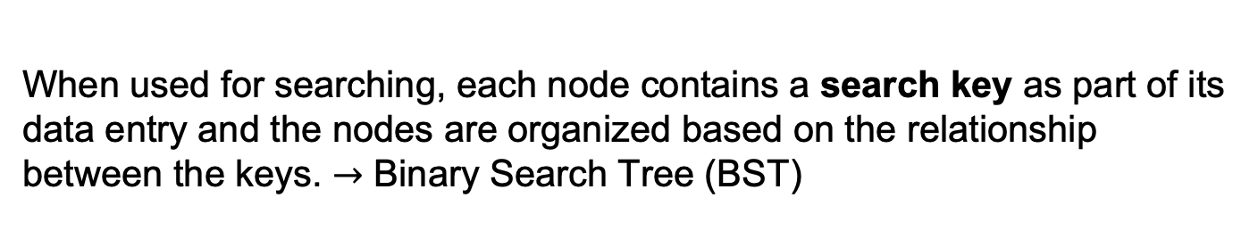
Binary Tree (Review)
The depth of a node is its distance from the root, with distance being the number of levels that separate the two. (it corresponds to the level it occupies)
The height of a binary tree T is the number of levels in the tree.
The width of a binary tree T is the number of nodes on the level containing the most nodes.
Depth(6) = 2
Height(T) = 3
Width(T) = 3
When used for searching, each node contains a search key as part of its data entry and the nodes are organized based on the relationship between the keys. $→$ Binary Search Tree (BST)

Slide 43
Tree Traversal
Traversal is one of the most common operations performed on collections of data
a traversal iterates through a collection, one item at a time, in order to access or visit each item.
Tree traversal in a binary tree implies that there is no single path from the root to every other node in the tree
if we simply follow the links, once we reach a leaf node, we cannot directly access any other node in the tree
Two approaches are possible:
Depth-first search
Breadth-first search
Given a binary tree of size n, a complete traversal can be done in O(n)

Slide 44
Tree Traversal
Depth-first search (DFS): the search tree is deepened as much as possible on each child before going to the next sibling.
Pre-order (NLR)
In-order (LNR)
Post-order (LRN)
Breadth-first search (BFS): visit every node on a level before going to a lower level.
Breadth-first search
Depth-first search

Slide 45
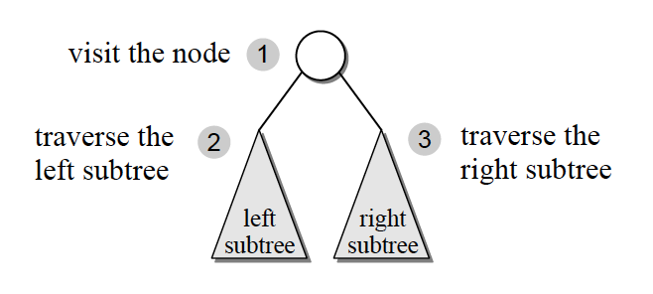
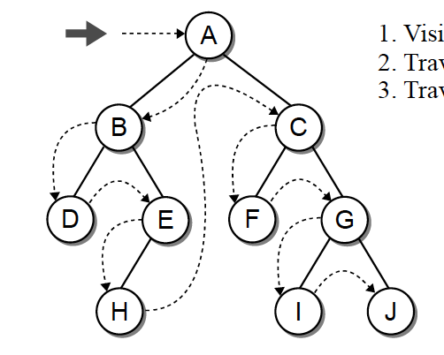
Depth-First Search: pre-order
Pre-order traversal (NLR)
Visit the root node (N)
Traverse the nodes in its left subtree (L)
Then, traverse the nodes in its right subtree (R)
Since each node is the root of its own subtree, we repeat the same process on each node => recursive algorithm
Data Structures and Algorithms Using Python, Rance D. Necaise. John Wiley&Sons,, 2010

Slide 46
Depth-First Search: pre-order
class Node: def __init__(self, data): self.left = None self.right = None self.data = data def preorder_traversal(self, root): res = [] if root: res.append(root.data) res = res + self.preorder_traversal(root.left) res = res + self.preorder_traversal(root.right) return res

Slide 47
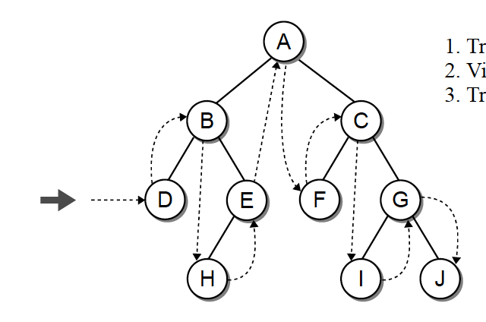
Depth-First Search: in-order
In-order traversal (LNR)
We first traverse the left subtree (L)
Then, traverse the node (N)
Finally, traverse the nodes in its right subtree (R)
The recursive function is almost identical to that of the pre-order
Data Structures and Algorithms Using Python, Rance D. Necaise. John Wiley&Sons,, 2010

Slide 48
Depth-First Search: in-order
class Node: def __init__(self, data): self.left = None self.right = None self.data = data def inorder_traversal(self, root): res = [] if root: res = res + self.inorder_traversal(root.left) res.append(root.data) res = res + self.inorder_traversal(root.right) return res

Slide 49
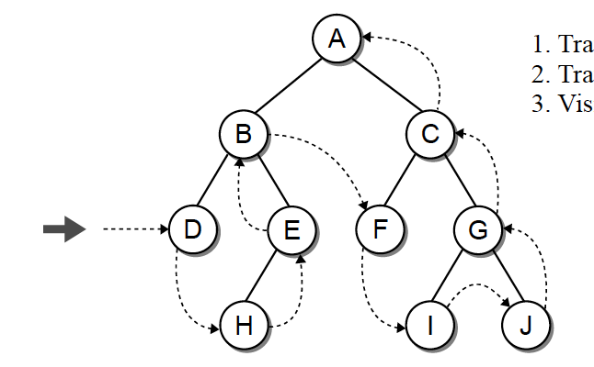
Depth-First Search: post-order
Post-order traversal (LRN)
Traverse the left subtree (L)
Traverse the right subtree (R)
Then, visit the node (N)
Data Structures and Algorithms Using Python, Rance D. Necaise. John Wiley&Sons,, 2010

Slide 50
Depth-First Search: post-order
class Node: def __init__(self, data): self.left = None self.right = None self.data = data def postorder_traversal(self, root): res = [] if root: res = res + self.postorder_traversal(root.left) res = res + self.postorder_traversal(root.right) res.append(root.data) return res

Slide 51
Docker

Slide 52
Problems with Reproducibility
- Everyone using your application has different operating systems, environments, etc.
- As libraries and dependencies change, it is important to keep track of all requirements needed to run.
- Production software must be easy to deploy and scale to handle more users.
- Anaconda helps some issues with reproducibility, but what if you want to use multiple languages or services together (e.g. Javscript Frontend, SQL database, etc.)?

Slide 53
Docker
Open source platform for developing, shipping, and running applications.
Docker packages an application in a loosely environment called a container.
Containers are lightweight and contain everything needed to run an application.
Containers are shareable so everyone works in the same way.
Docker is considered an industry standard.

Slide 54
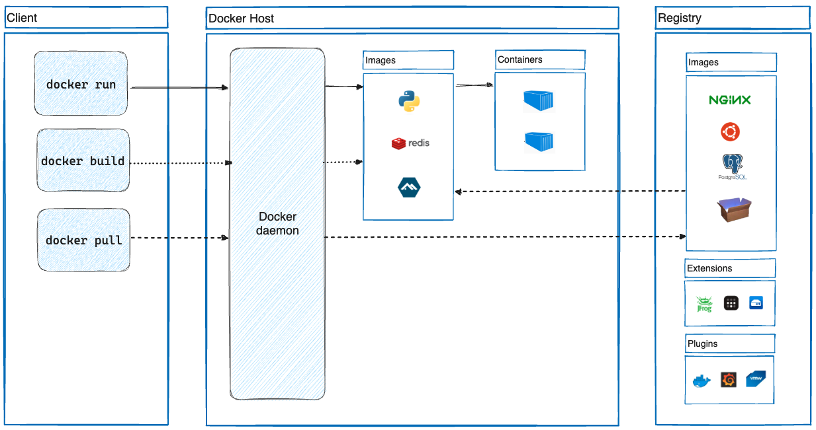
Docker Architecture

Slide 55
Docker Architecture
The docker client is the primary way to interact with Docker.

Slide 56
Common Docker Commands
docker build
docker images
docker run
docker ps
docker stop
docker rm
docker rmi docker images
# build an image from a dockerfile
# list all available images
# run an image
# list all running and stopped instances
# stop a running image
# remove an instance
# remove an image

Slide 57
Docker Architecture
You can run commands to interface with the Docker API.

Slide 58
Docker Architecture
The Docker daemon listens for Docker API requests and manages Docker objects such as images and containers.

Slide 59
Docker Architecture
A Docker image is read-only template with instructions to create a Docker container.

Slide 60
Docker Architecture
Images are often based on another image with additional customization. For example, you may build a web app image based on an “Ubuntu” image.

Slide 61
Docker Architecture
To build an image, you can create a Dockerfile to define the steps needed to create an image and run it.

Slide 62
Docker Architecture
Each time you change a Dockerfile and rebuild the image, only the layers which have changed are rebuilt. This makes images lightweight, small, and fast.

Slide 63
Example Python Dockerfile
FROM python:3
WORKDIR /usr/src/app
COPY requirements.txt ./
RUN pip install --no-cache-dir -r requirements.txt COPY . .
CMD [ "python", "./your-daemon-or-script.py" ]

Slide 64
Docker Architecture
Containers are runnable instances of an image. By default, they are well isolated from other containers and the host machine.

Slide 65
Docker Architecture
A Docker registry stores Docker images. You can store images publicly at Docker Hub or run your own private registry.

Slide 66
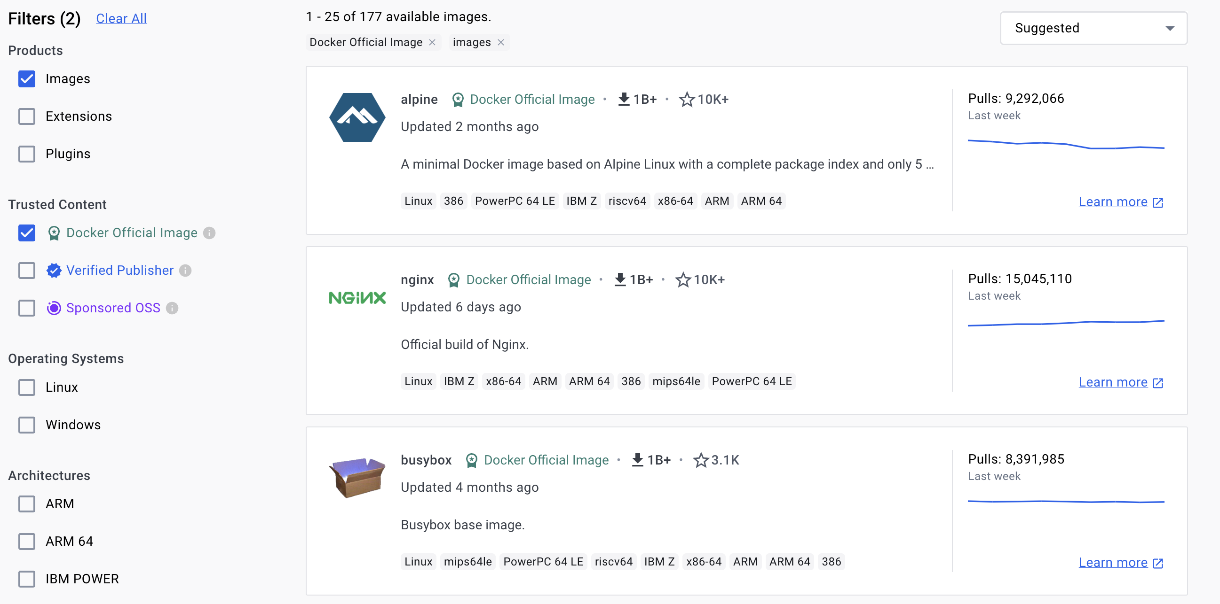
Dockerhub

Slide 67
Docker vs Traditional Virtualization
Docker Containers | Virtual Machines (VMs)
Shared Operating System: Containers share the host's OS kernel, requiring less overhead. | Separate Operating Systems: Each VM runs its own full instance of an OS, leading to more overhead.
Lightweight and Fast: Containers are small in size and start almost instantly, allowing for rapid scaling. | Heavier and Slower: VMs are larger in size and take longer to boot, impacting scaling speed.
Application-Centric: Designed primarily for running applications in isolated environments with minimal excess baggage. | Hardware-Centric: Emulates a full hardware system and can run entire operating systems and applications.
Efficient Resource Utilization: More efficient use of system resources like CPU and memory. | Higher Resource Requirement: Requires more resources due to running full OS instances.

Slide 68
FastAPi

Slide 69
Python Web Frameworks
Python is also commonly used to develop web appplications.
An application programming interface (API) is a way for two or more computer programs to communicate with each other.
Some common frameworks include Django, Flask, and FastAPI.
We will focus on FastAPI, a modern web framework for building RESTful APIs in Python.

Slide 70
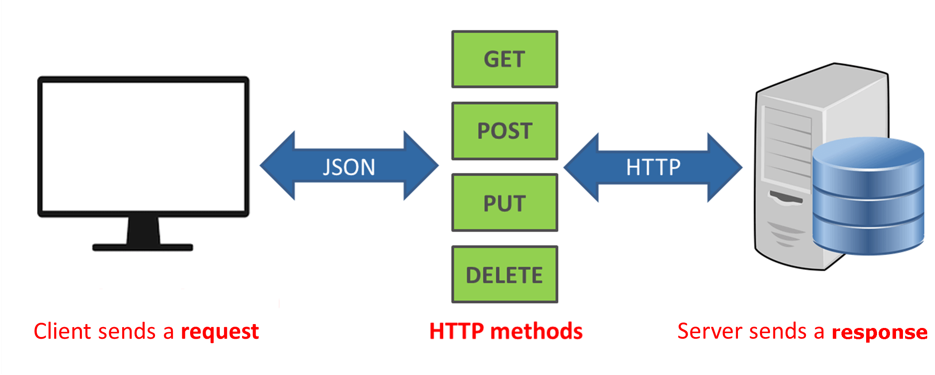
REST API
REST (Representational state transfer) is a software architectural style that was created to guide the design and development of the architecture for the World Wide Web.
REST APIs send HTTP requests to the backend to perform functions like create, read, update, and delete (known as CRUD).

Slide 71
Example REST API
Operation | HTTP Method | Endpoint | Description
Create | POST | /api/books | Adds a new book to the collection.
Read | GET | /api/books <br> /api/books/{id} | Fetches all books or a specific book by ID.
Update | PUT/PATCH | /api/books/{id} | Updates the details of a specific book.
Delete | DELETE | /api/books/{id} | Deletes a specific book from the collection.

Slide 72
FastAPI
FastAPI is a modern web framework for building APIs
FastAPI offers high performance, comparable to NodeJS and Go, due to its asynchronous programming capabilities and efficient handling of concurrent requests.
It simplifies API development with automatic request validation, serialization, and interactive documentation using Swagger and ReDoc.
FastAPI leverages modern Python features like type hints and Pydantic models, enhancing code quality, reducing development errors, and improving editor support.

Slide 73
Example API
from fastapi import FastAPI
app = FastAPI()
@app.get("/")
async def root():
return {"message": "Hello World"}

Slide 74
DEMO

Slide 75
main.py contains our backend api that we will call. Next we will fill out our Dockerfile.
from typing import Union
from fastapi import FastAPI
app = FastAPI()
@app.get("/")
def read_root():
return {"Hello": "World"}
@app.get("/items/{item_id}")
def read_item(item_id: int, q: Union[str, None] = None):
return {"item_id": item_id, "q": q}

Slide 76
# Start from the official Python base image.
FROM python:3.9
# Set the current working directory to /code.
WORKDIR /code
# Copy the file with the requirements to the /code directory.
COPY ./requirements.txt /code/requirements.txt
# Install the package dependencies in the requirements file.
RUN pip install --no-cache-dir --upgrade -r /code/requirements.txt
# Copy the ./app directory inside the /code directory.
COPY ./app /code/app
# Set the command to run the uvicorn server.
CMD ["uvicorn", "app.main:app", "--host", "0.0.0.0", "--port", "80"]

Slide 77
First, build the image:
$ docker build -t myimage .
Then, run the image: $ docker run -d --name mycontainer -p 80:80 myimage
If we go to http://127.0.0.1/items/5?q=somequery, we can see the result from our GET request:
{"item_id": 5, "q": "somequery"}

Slide 78
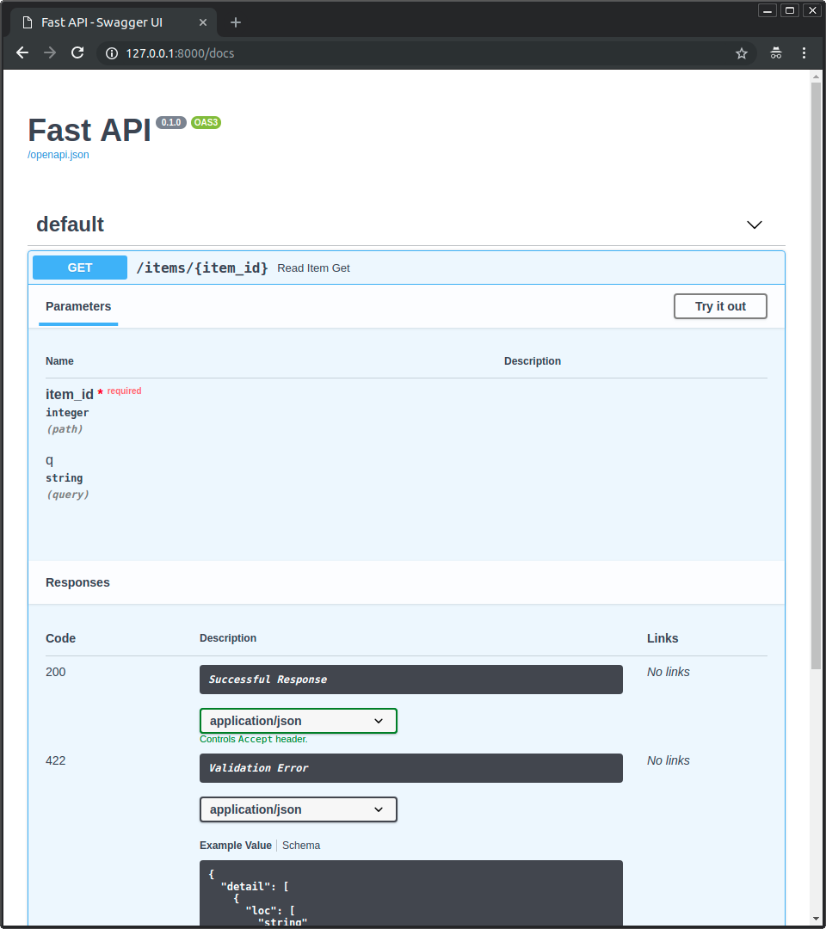
To see interactive API docs, go to: http://127.0.0.1/docs

